Slide 1

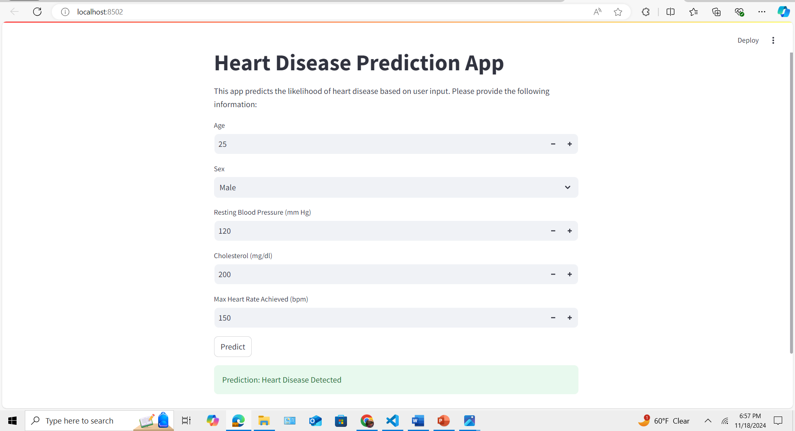
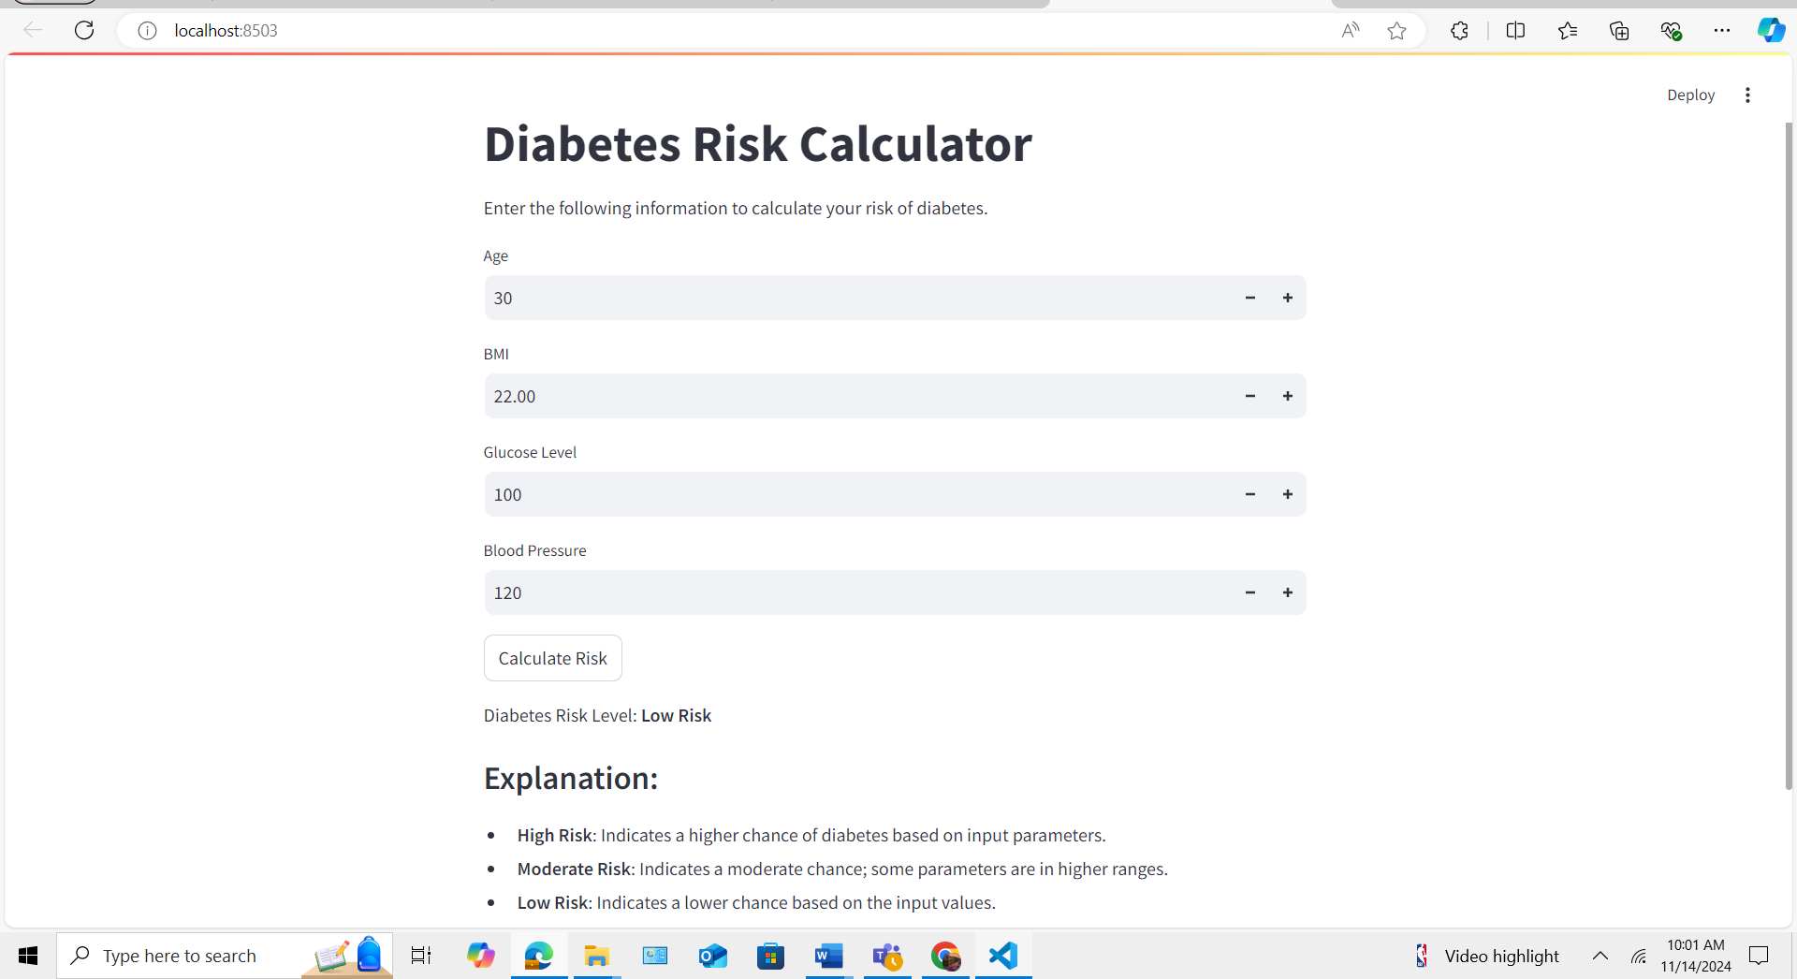
AI-powered Predictive Healthcare System “Predicting Health for a Better Tomorrow” By Ilhem Touati & Adama Diallo https://github.com/ksu-hmi/AI-Powered-Preventive-Healthcare-System
Data Modeling:
LogisticRegression
DecisionTreeClassifier
SVC
KNeighborsClassifier
RandomForestClassifier
Gradient Boosting Classifier and XGBoost

